Slide 1
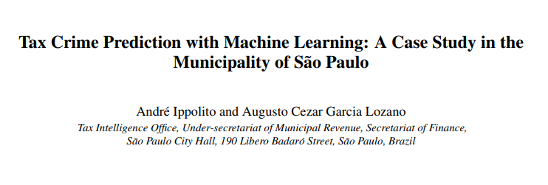
TAX CRIME PREDICTION USING ML
By:
Group 10
Soumya Dasgupta (1911164)
Akankshya Nayak (1911018)
Lozano, Augusto & Ippolito, André. (2021). Tax Crime Prediction with Machine Learning: A Case Study in the Municipality of São Paulo.

Slide 2
SPECIFIC OBJECTIVES:
Train a model according to the Indian Tax System
Predict Tax Fine Values
Applying Principal Component Analysis
Inclusion of Time Variable

